Slide 1

Collab@
InSiGHT

Slide 2
Study overview
Title of Study: A worldwide approach to improve management for families with Hereditary Diffuse Gastric Cancer (HDGC)
Lead Institution(s): i3S - INSTITUTO DE INVESTIGACAO E INOVACAO EM SAUDE DA UNIVERSIDADE DO PORTO
Principal Investigator(s): Prof. Carla Oliveira
Contact Email (optional): carlaol@i3s.up.pt; jpelaezsolverd@outlook.com
Background: (Brief context or problem) Different phenotypic presentations may occur at different frequencies in families carrying CDH1 pathogenic or likely pathogenic variants, influenced by geographic origin, environmental exposures, and modifier genetic factors (Garcia-Pelaez et al., Lancet Oncology 2023); limited genotype-phenotype associations on CDH1 germline variant carriers with scarce clinical information and restricted to a specific geographic region are currently available jeopardizing clinical criteria design and management of families

Slide 3
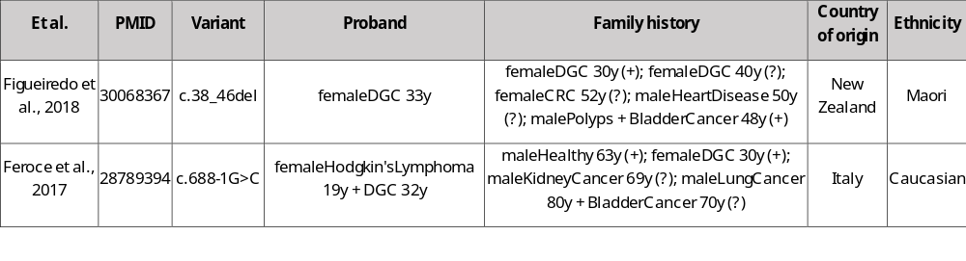
Study overview
Objective: (Aim or research question) Study the geographic-specific disease spectrum among CDH1 carriers to confer region and variant-specific management strategies for HDGC families through clinical guidelines improvement
Design/Methods: We will be collecting retrospective clinical data from families carrying pathogenic/Likely pathogenic (PV/LPV) CDH1 germline variants
Results: (Main findings)
-We have compiled detailed retrospective clinical information from 1033 CDH1-PV/LPV carrier families worldwide presenting 4176 phenotypes, from 36 countries and 5 continents in a single database – the largest dataset ever of its sort
-We have already curated the molecular and ACMG classification for 327 CDH1 PV/LPV

Slide 4
Study overview
Conclusion: (Key takeaway)
-This study highlights the critical importance of accurate clinical data collection to enable appropriate management tailored to geographic location and associated disease risks.
-A substantial proportion of families carrying PV/LPV present only breast cancer (BC) in their family history, particularly in the Americas; however, due to a bias towards gastric cancer (GC) in current clinical criteria, families presenting LBC-only in family history often do not meet these criteria.
-While Europe and North America are overrepresented, other regions, namely Africa, Asia, Latin America and Oceania, remain underrepresented.
Significance: (Why it matters?)
The International Gastric Cancer Linkage Consortium (IGCLC) is currently updating its clinical guidelines and addressing several key uncertainties, including the refinement of clinical criteria for CDH1 testing; CDH1-associated predisposition to lobular breast cancer; phenotypic variability influenced by geographic origin; specificities in CDH1 variant-type related clinical phenotypes (including molecular classification and variant location); and optimization of timely clinical management for both gastric and breast cancer types.
Following our previous initiative lead by our group and performed under the umbrella of the European Reference Network on Genetic Tumor-Risk Syndromes (ERN-GENTURIS) which results are already published in The Lancet Oncology (Garcia-Pelaez et al., Lancet Oncology 2023), we already have a robust database built through internal communications and the systematic compilation of clinical data from 158 articles published since 1993. This resource will support the continued advancement of this challenging initiative and contribute to an improved and more personalized clinical management for CDH1 variant carriers.

Slide 5
